Slide 1
Business plan *Retromanija*
Authors: Kristina Gavrilović Uroš Poznan
Faculty of Mathematics University of Belgrade
2020.
Menthors: Prof. dr Veljko Milutinović
Aleksandar Veljković
1/10

Slide 2

Are you into Retro stuff?
Great! We have something for you…
You sure? Maybe we have something for you…take a look
2/10

Slide 3
Where to buy retro things?
Instagram??
Facebook???
Ship from abroad???
Retromanija? hmm
3/10

Slide 4

4/10

Slide 5
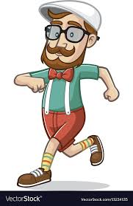
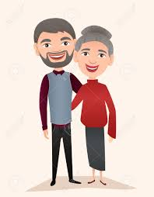
Who is buying?
5/10

Slide 6

Item categories.
Accessories – glasses, watches,...
Household – iron, coffee grinder, vacuum cleaner,…
Technical gadgets – Polaroid, Walkman,…
Souvenirs – various items, music box, toys,
Bicycles
6/10

Slide 7
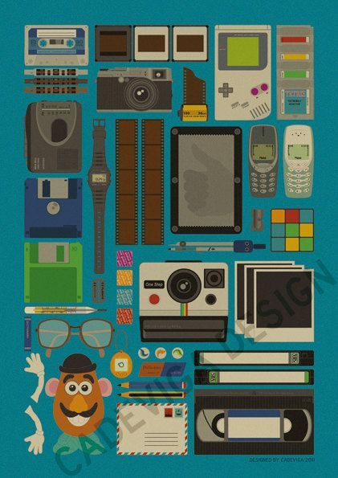
-Do you have _____? -Ah, sorry, we don’t.
-Okay, by.. -BUT WE WILL! Thanks for suggesting and be patient. -You’re very welcome. Let me know when you get it!
7/10

Slide 8

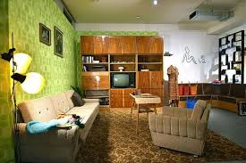

Advertising…
8/10

Slide 9
We’ve got stuff.
We need staff!
People we need to get started:
-a web designer
-web developers
People we need to keep things going:
- social media experts
- delivery guys
- ‘’flyers’’
9/10

Slide 10
Thanks for your attention!
Authors: Kristina Gavrilović Uroš Poznan
Questions?
10/10

